Slide 1
New Spin on Double Crop Soybeans

Slide 2
The Standard for Double Crop Soybeans

Slide 3
Planting Green into a mix

Slide 4
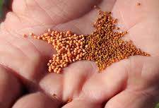
Nitrogen Source
Excellent Companion Crop
100 lbs. of N per acre
2-4D will terminate
Mixed with wheat seed 1:1

Slide 5
What if?

Slide 6
How do We Make it Work Here

